Slide 1


V D S Krishna
Sr. Assistant Professor
CVRCE

Slide 2
What is a prototype?
JavaScript is a bit confusing for developers experienced in class-based languages (like Java or C++), as it is dynamic and does not provide a class implementation by itself (the class keyword is introduced in ES6, but is syntactical sugar, JavaScript remains prototype-based).
Each and every object in JavaScript automatically has a property called Prototype.
Each object has a private(hidden) property which holds a link to another object called its prototype.
When we create an object, JavaScript engine automatically puts this hidden property into an object and attaches it to your object.

Slide 3
Prototype
Example:
var arr = [3, 6, 9, 5];
console.log(arr.__proto__);
It’s just an object attaches to each and everything that you create in JavaScript i.e., either an object, an array or a function.

Slide 4
Prototype Chain
arr.__proto__ is same as Array.prototype.
So, arr.__proto__. __proto__ also has a prototype, that is Object.prototype.
And, arr.__proto__. __proto__ . __proto__ is null.
That justifies that, everything in JavaScript is an object.
This is called as Prototype chain.

Slide 5
Prototype Property
Each and every function in JavaScript automatically has a property called Prototype(that includes constructor function).
Every object created by a constructor function will get accessed by all the methods and properties that we define on the constructor prototype property.

Slide 6
Prototype Property
var Person = function (firstName, birthYear) {
this.firstName = firstName;
this.birthYear = birthYear;
};
Person.prototype.calAge = function () {
console.log(2023 - this.birthYear);
};

Slide 7
Prototype Property
Now, each object created by this constructor function will now get access to all the methods of this prototype property and of course to calAge().
var John = new Person("John", 1990);
John.calAge();
calAge() property is not part of John, its part of its prototype.

Slide 8
Prototypal Inheritance
That effectively solves the problem that we had before when we added the calAge() method directly to each of the objects.
Instead, what we do is this [Person.prototype.calAge()] because, now there exists only one copy of this function.
So, only one copy exists and all the objects that are created using this constructor function can basically reuse this function(calAge()).
In nutshell, this is how we implement Prototypal Inheritance.

Slide 9
__proto__
Each object has a special property called __proto__.
Its not the prototype property, its simply the prototype.
Any object always has access to the methods and properties from its prototype, and the prototype of John and Jack is Person.prototype.
The prototype of John is essentially the prototype property of the constructor function.
console.log(John.__proto__ === Person.prototype); // true

Slide 10
__proto__
Person.prototype is not the prototype of Person, indeed its the prototype of all the objects that are created with the Person constructor function.
console.log(Person.prototype.isPrototypeOf(John)); //true
But, Person.prototype is not the prototype of Person.
console.log(Person.prototype.isPrototypeOf(Person)); //false
We can also set the properties, not only the methods.
Person.prototype.species = "Homo Sapiens";
console.log(John.species, Jack.species); // Homo Sapiens Homo Sapiens

Slide 11
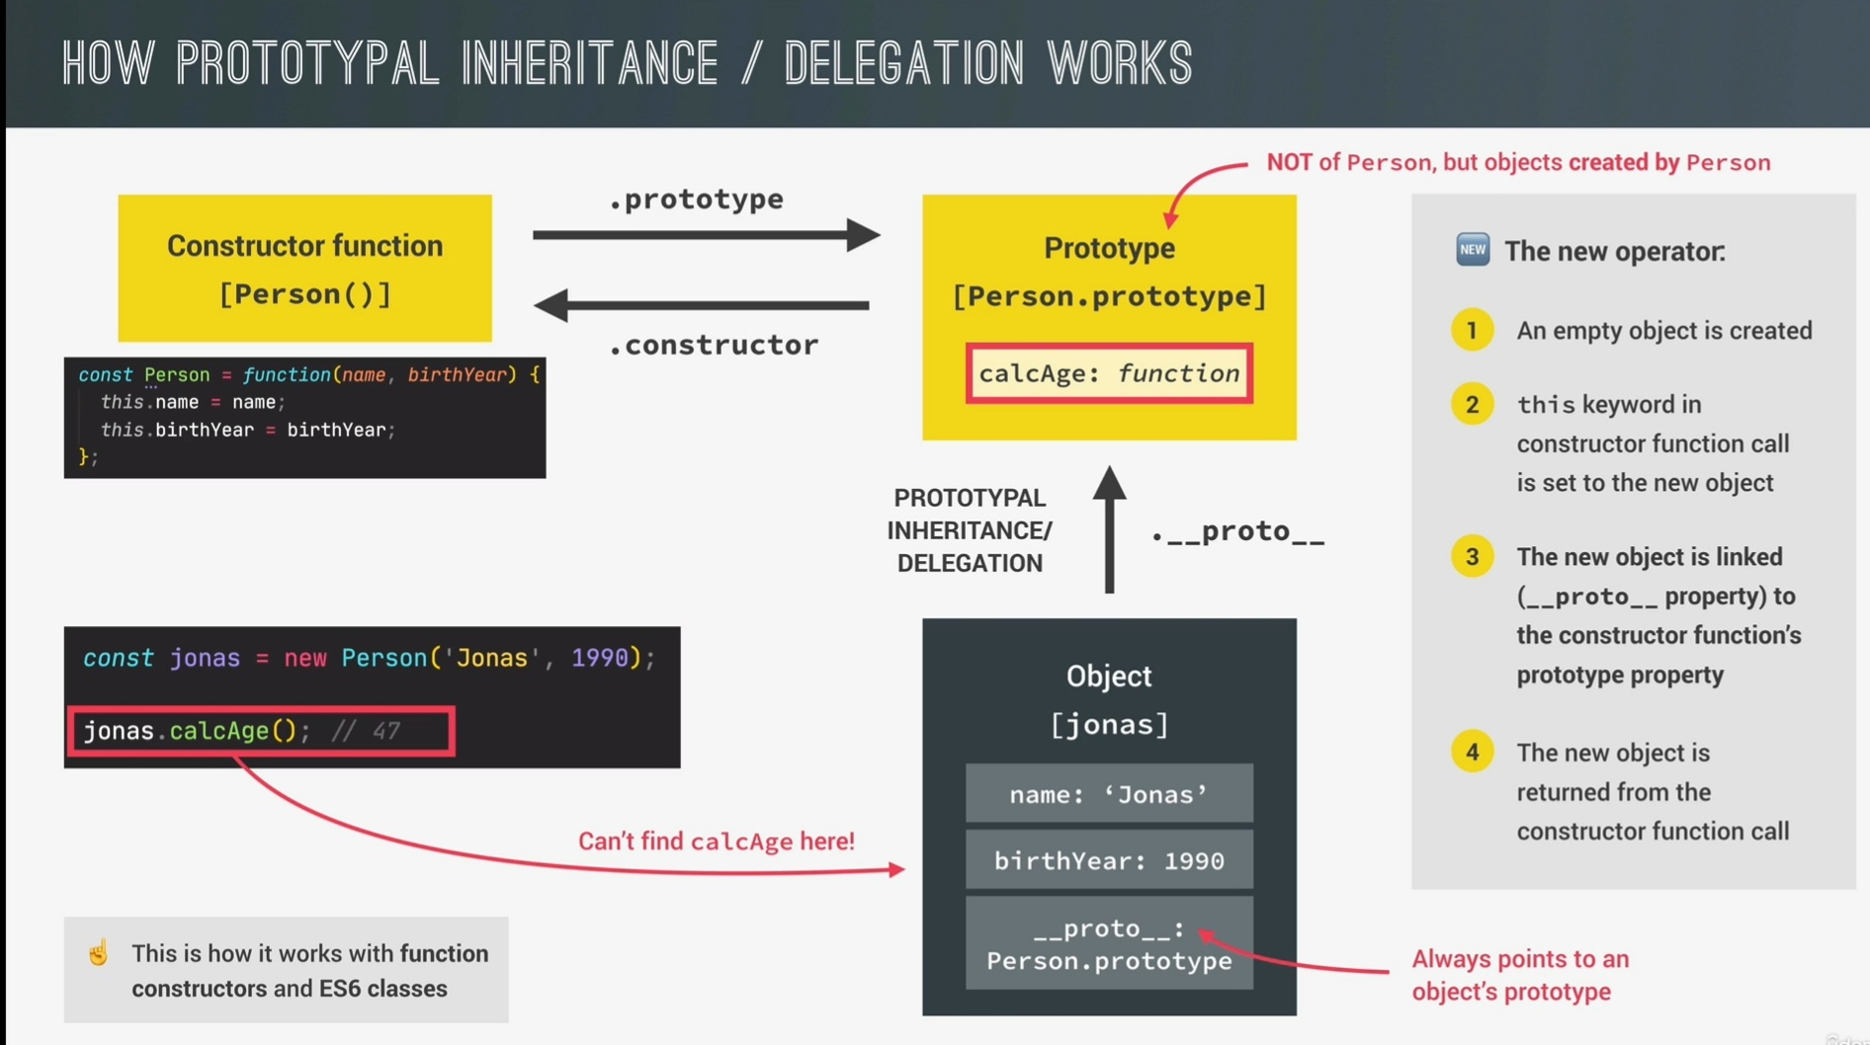

Slide 12
